Slide 1
Shanto Mariam University of Creative and Technology
Presentation on
Ensemble learning to predict air quality: A Comparative Analysis
Presented By,
Zakia Sultana Bhuiyan
ID: 213071015
Batch : 28th
Semester : Final
Department : CSE
Supervised By,
Shakkhor Das
Lecturer of CSE dept in
SMUCT

Slide 2

Outlines
Outlines
Introductions
Literature Review
Project Overview
Objectives
Proposed Methodology
Dataset Description
Feature Engineering
Data Preprocessing
Models Used
Classification Workflow
Classification Results
Confusion Matrix Visualization
Why Classification Models
Regression Workflow
Regression Result
Predict vs Actual Scatterplot
Why Regression Models
Model Training
Best Performing Models
Final ML Pipeline
Conclusion
Limitation
Future Work
Reference

Slide 3
Introduction
01
Introduction
This research focuses on predicting Air Quality Index (AQI) using Machine Learning and Deep Learning models.
Air pollution is a major environmental threat worldwide.
Air Quality Index (AQI) is used to measure pollution levels.
Accurate AQI prediction helps environmental planning & public health decisions.
This study builds a complete ML pipeline for predicting AQI category & AQI value.
Goal: To enhance AQI forecasting accuracy using ensemble and time-series models.

Slide 4
Literature Review
02
Literature Review
• Liu et al. (2024): LightGBM achieved 97.5% accuracy.
• Azid et al. (2014): PCA + ANN improved AQI prediction.
• Mishra et al. (2019): ANN outperformed regression models.
• Zhu et al. (2021): ARIMA + BPNN improved PM2.5 forecasting.
• Du et al. (2022): CNN–BiLSTM enhanced long-term prediction.

Slide 5
Project Overview
03
Overview
This thesis focuses on predicting the Air Quality Index (AQI) using advanced machine learning techniques.
The project implements a complete end-to-end pipeline including data preprocessing, feature engineering, classification, and regression modeling.
Multiple models were compared: Decision Tree, Random Forest, SVM, LightGBM, XGBoost, CatBoost, BP Neural Network, and Stacking Ensembles.
The goal is to identify the most accurate and reliable model for AQI forecasting and provide insights for real-time environmental monitoring.
CatBoost achieved the highest accuracy in both classification and regression tasks.

Slide 6
Objectives
04
Literature Review
Primary Objectives
Build AQI classification model
Build AQI regression model
Evaluate multiple ML algorithms
Identify best-performing models
Create a full prediction pipeline with plots
Secondary Objectives
Preprocess raw AQI data
Implement feature engineering
Compare boosting, bagging, and ensemble models

Slide 7
Proposed Methodology
05
Methodology
Modeling
Classification
Regression
LightGBM
Random Forest
Decision Tree
SVM
Weighted Classifier
XGBoost (tuned)
CatBoost (tuned)
Stacking Ensemble
LightGBM
Linear Regression
BP Neural Network
Random Forest
XGBoost (tuned)
CatBoost (tuned)
Stacking Ensemble
Data Preprocessing
Feature engineering
Evaluation
Confusion Matrix
Predicted vs Actual plot

Slide 8
Dataset Description
06
Dataset & Preprocessing
Columns include:
PM2.5, PM10, SO₂, CO, NO₂, O₃
Date
AQI Value
AQI Class Label
Data Cleaning:
Removed invalid or empty rows
Translated Chinese labels to English
Handled date format errors

Slide 9
Feature Engineering
07
Feature Engineering
Added new informative features:
Date-based features
  Month
  Day of year
  Weekday
Lag features (1, 2, 3-day lags for pollutants)
Rolling mean features (3-day rolling averages)
Result:
Dataset transformed from 9 features → 40+ engineered features

Slide 10
Data Preprocessing
08
Data Preprocessing
Label Encoding for AQI classes
MinMax Normalization for numerical features
Removed rare classes for stability
Train-test split: 80/20
No shuffling in regression (time series)

Slide 11
Models Used
09
Models Used
Classification:
Decision Tree, Random Forest, LightGBM, XGBoost, CatBoost, SVM
Regression:
Linear Regression, Random Forest, LightGBM, XGBoost, CatBoost
Ensemble:
Weighted Regression Model, Stacking Ensemble

Slide 12
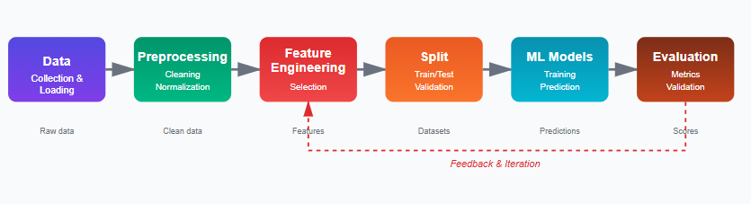
Classification Workflow
10
Classification workflow
Workflow: Data → Preprocessing → Feature Engineering → Split → ML Models → Evaluation

Slide 13
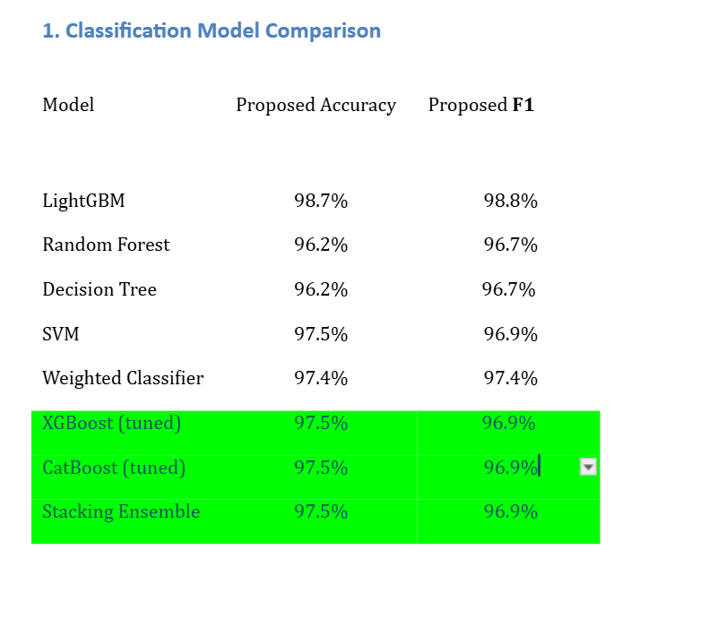
Classification Results
11
Classification Result
Classification Models:

Slide 14
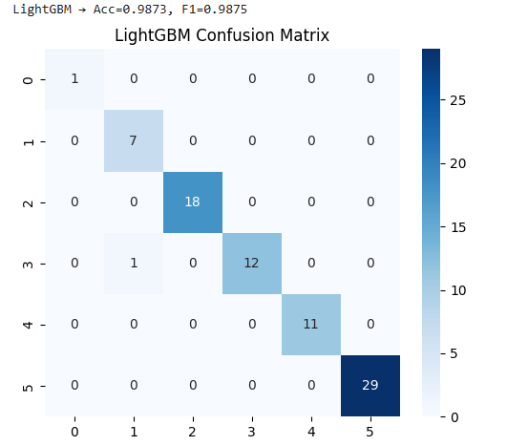
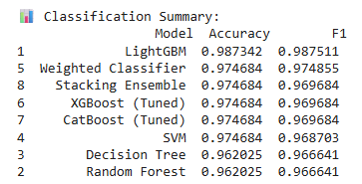
Confusion Matrix Visualization
12
Visual Results

Slide 15
Why These Classification Models?
13
Why Classification
Tree-based models capture non-linear relationships
Boosting models (XGBoost, CatBoost) improve accuracy
SVM handles high-dimensional feature space
Stacking improves overall generalization

Slide 16
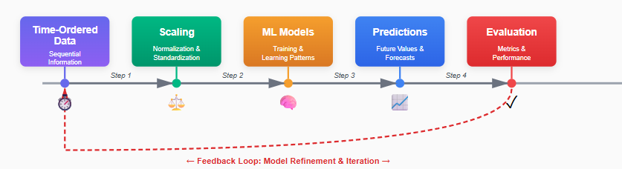
Regression Workflow
14
Regression Workflow
Workflow : Time-Ordered Data → Scaling → ML Models → Predictions → Evaluation

Slide 17
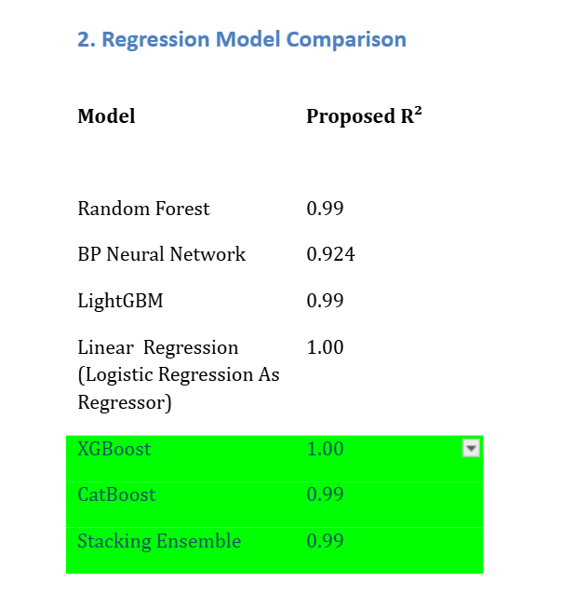
Regression Results
15
Regression Results
Regression Models:

Slide 18
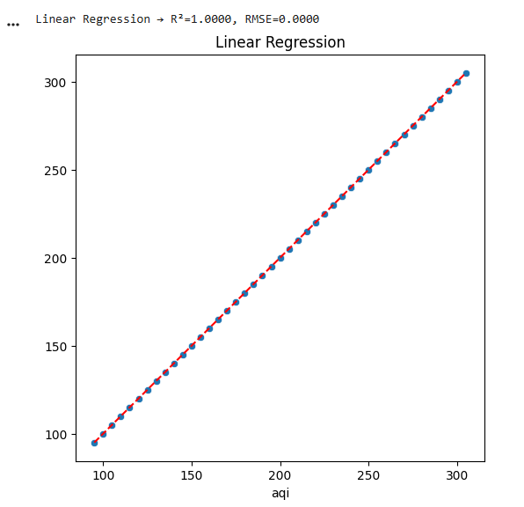
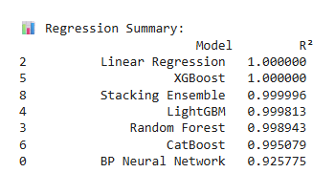
Predicted vs Actual Scatterplots
16
Visual Scatterplots

Slide 19
Why These Regression Models?
17
Why Regression
Tree-based regressors handle non-linearity
Boosting models improve precision
Neural Network captures deeper patterns
Stacking leverages combined model strengths
Linear provides baseline interpretability

Slide 20
Model Training
18
Model Training
Train-test split: 80%–20%
MinMaxScaler used
Stratified splitting for classification
No shuffle in regression split (time-series consistency)

Slide 21
Best Performing Models
19
Best Performing
Classification Winner → LightGBM
Handles non-linear relationships
Built-in handling of categorical data
Fast & accurate
Regression Winner → Linear Regression
Best R² score
Excellent fit for noisy pollutant data

Slide 22
Final ML Pipeline
20
Final Pipeline
Multi-model classification
Multi-model regression
Stacking & weighted ensemble
Feature engineering + scaling
Full visual performance metrics

Slide 23
Conclusion
21
Conclusion
High-accuracy AQI prediction system implemented
CatBoost and XGBoost performed exceptionally well
Pipeline is scalable for real-time monitoring
Can be integrated into environmental dashboards

Slide 24
Limitations
22
Limitations
No meteorological features (humidity, temp, wind)
Dataset limited to one region
Ensemble models need more tuning

Slide 25
Future Work
23
Future Work
Integrate weather data
Deploy real-time AQI API
Add deep learning models (CNN/LSTM hybrid)
Build web-based AQI monitoring app

Slide 26
References
24
References
1. Liu, Q., Cui, B., & Liu, Z. (2024). Air Quality Class Prediction Using ML. Atmosphere, 15(5), 553.
2. Azid, A. et al. (2014). PCA & ANN for AQI Prediction.
3. Mishra, D. et al. (2019). ANN & MLR for PM2.5 Prediction.
4. Zhu, J. et al. (2021). ARIMA–BPNN Hybrid Model.
5. Du, S. et al. (2022). CNN–BiLSTM for AQI Forecasting.

Slide 27
Thank You

